Slide 1
Five Dangerous Things
every school should measure
Gever Tulley - tinkeringschool.com

Slide 2
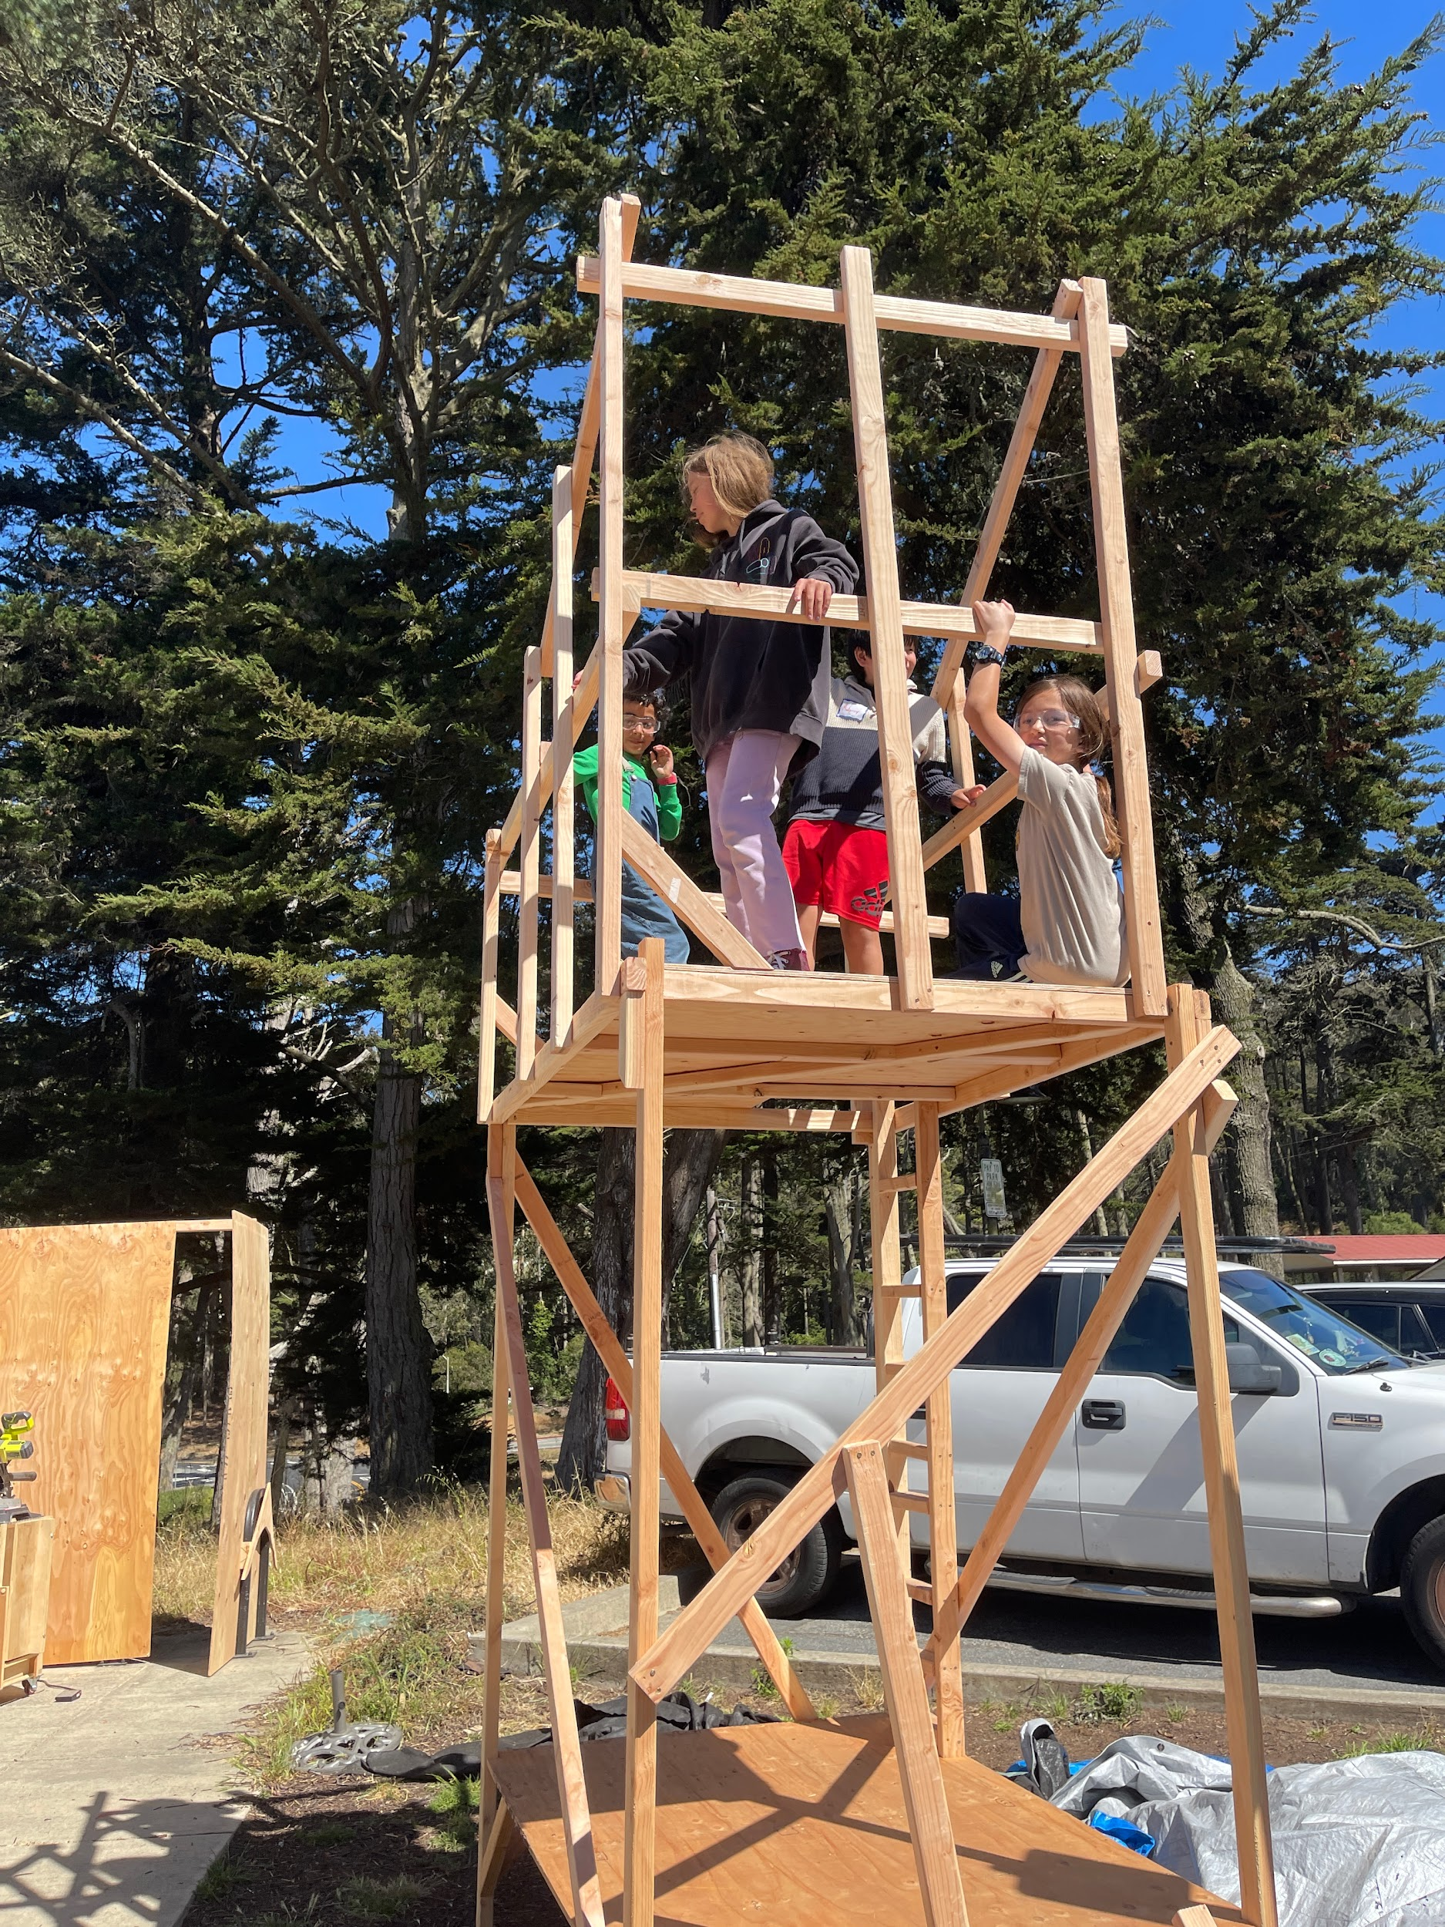

Slide 3
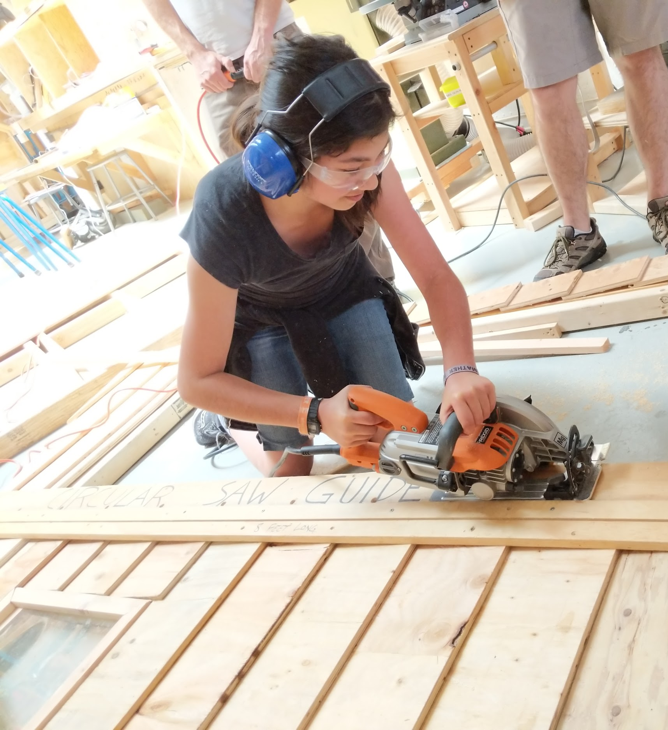

Slide 4
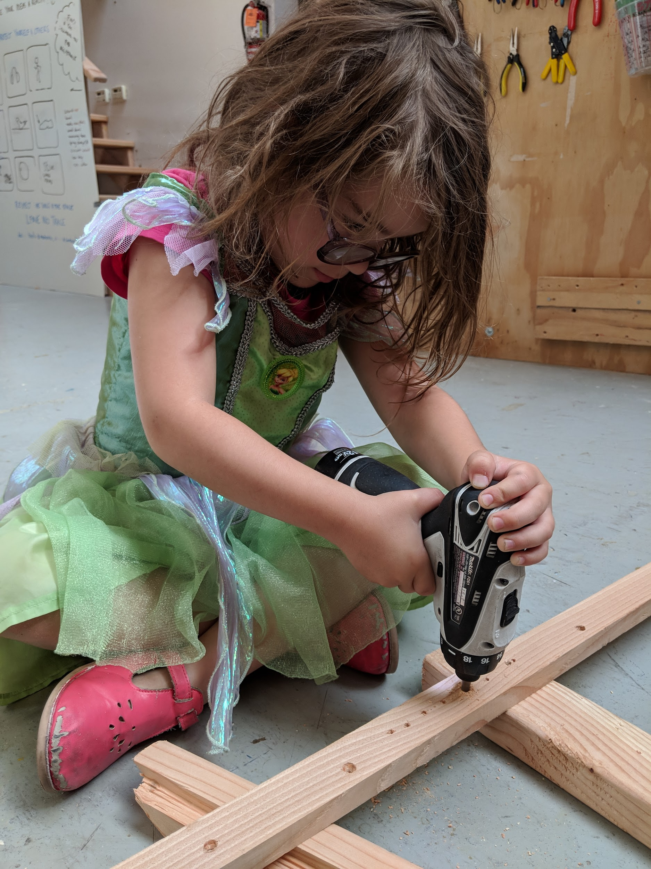
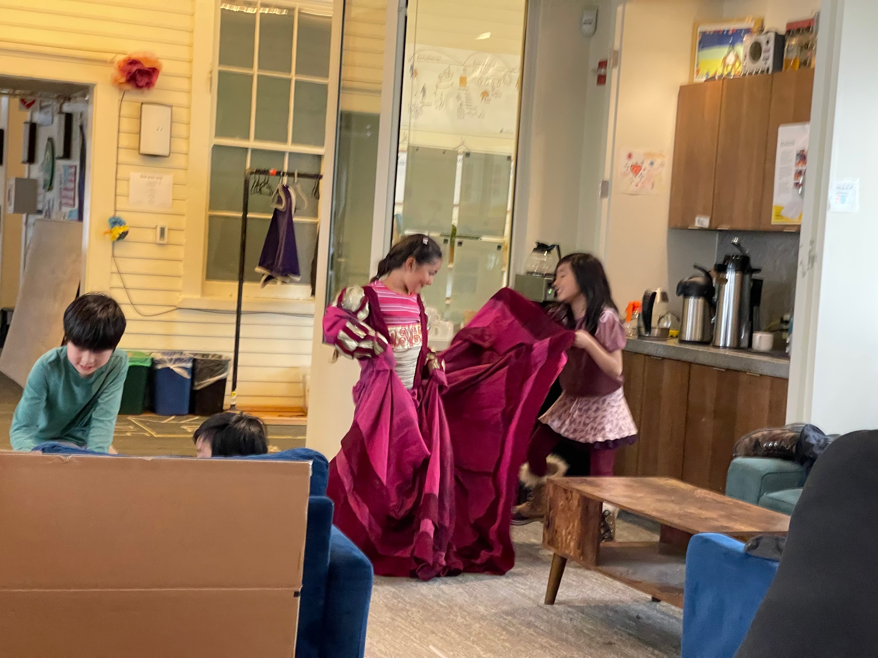

Slide 5
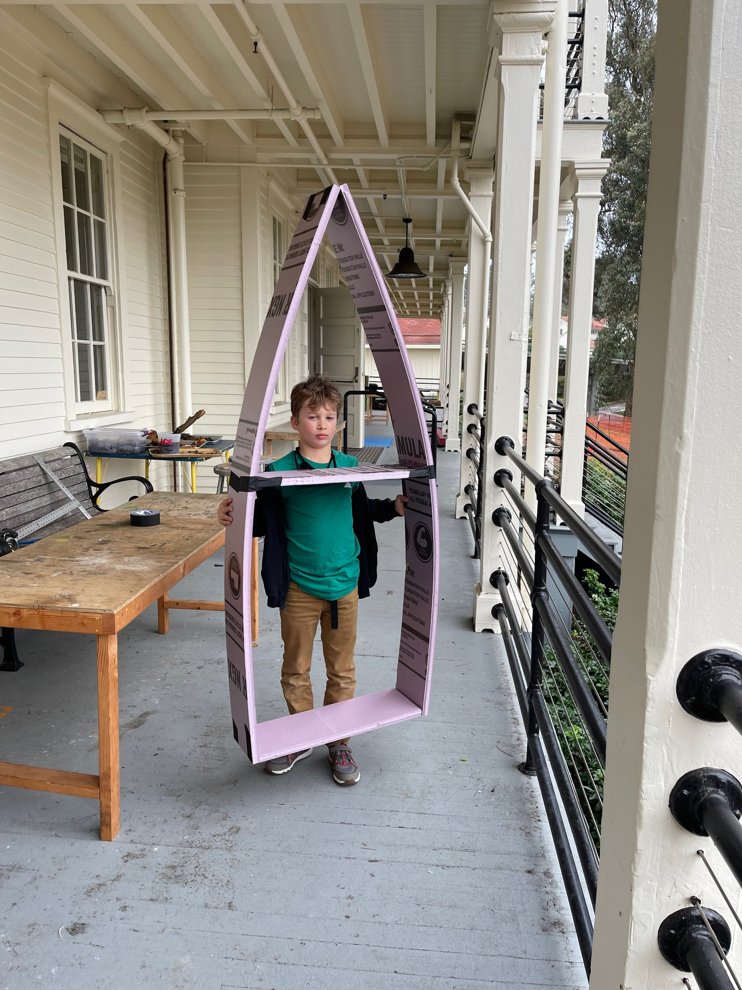

Slide 6
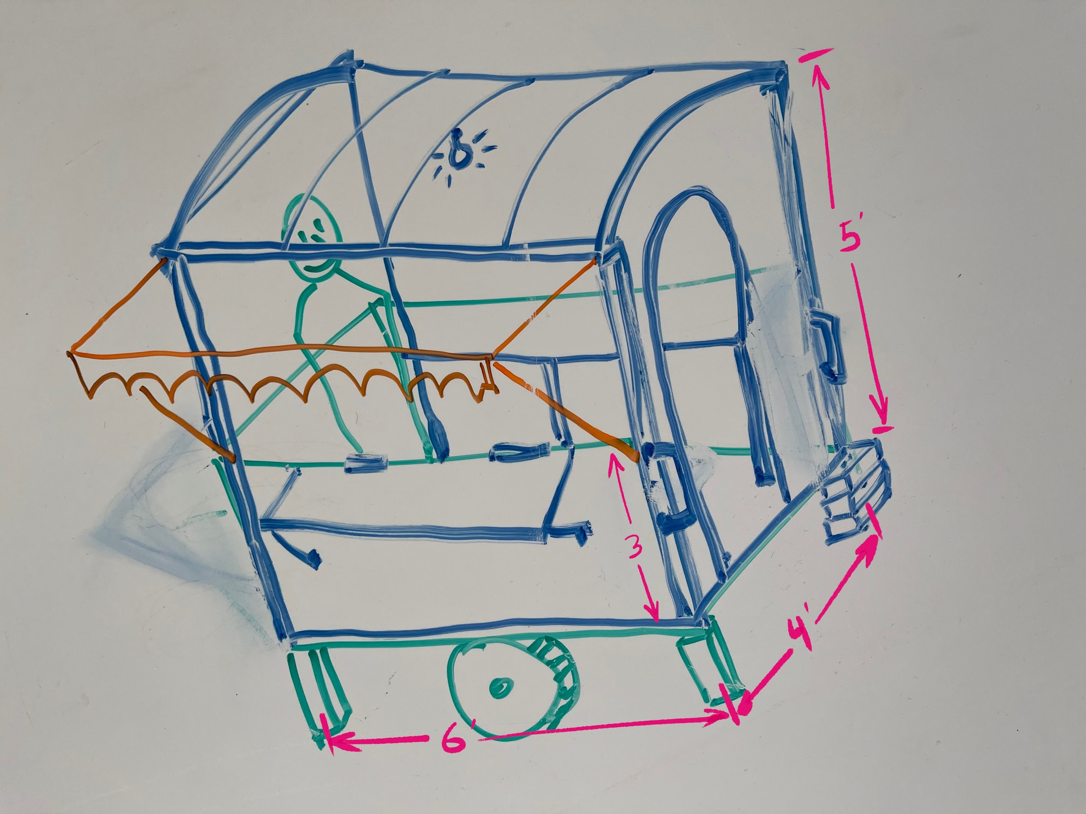
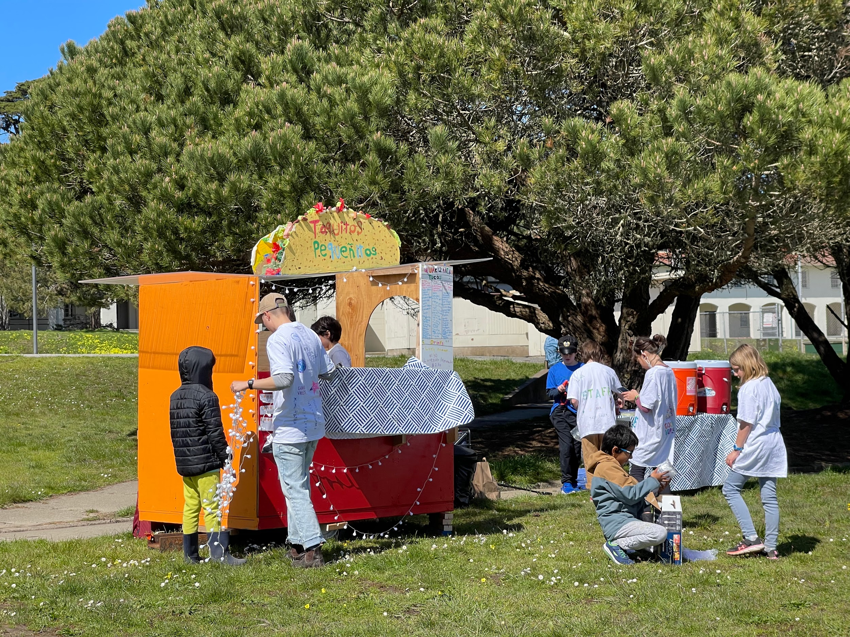
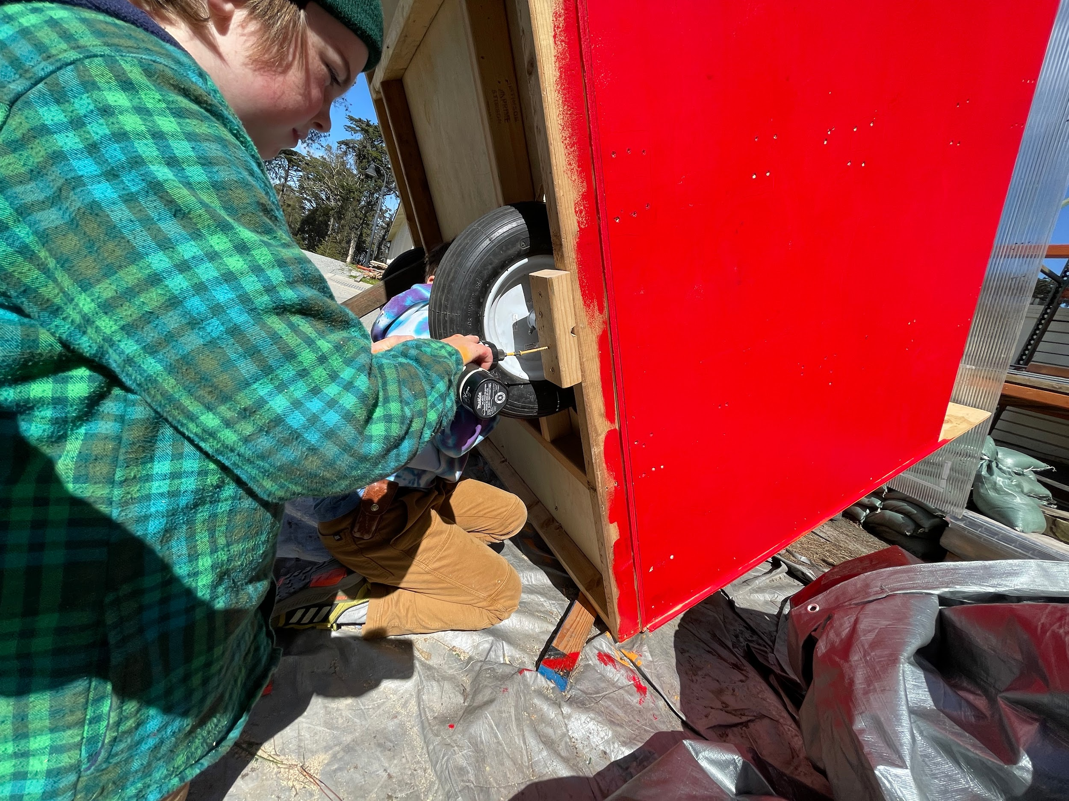

Slide 8
"When a measure becomes a target,
it ceases to be a good measure."
Charles Goodhart
Notes:
The problem is... there are negative impacts from over-emphasis on academics that are having significant mental health impact. In Canada, a recent study showed that mental health service usage in the 14-24 age range directly tracks test schedules in high schools, colleges, and universities - with near-zero usage during the winter and summer breaks. These long periods of high-stress damage the adolescent brain, establish patterns of anxiety when presented with challenging situations, and generally lead to self-doubt, isolation, and depression.

Slide 9
How do we change schools so that the things they measure do not harm the student?
Notes:
In our admissions process, one of the most common answers to the question "What do you want for your child?" is "I just want her to be happy." I love this answer, but it doesn't seem to fit the evidence. In exit interviews, many parents tell us they are leaving to get "more academic rigor", or to get "ready for college". It is at this point that we can ask the question:
*How do we change schools so that the things they measure do not harm the student?
Can the work of the student obviate the need for one-dimensional grades? Can we create experiences that promote intrinsically motivated learning and do not rely on top-down extrinsically defined goals? What could we measure and optimize that would, as a side-effect, predispose schools to create ever more productive, positive, and co-creative learning experiences?*
What we know now is that we are currently testing for the wrong things, and that the testing is shaping every aspect of education from policy to classroom management - so we must change what we test if we are to change education.

Slide 10
Notes:
Here, in no particular order are things that, when made the focus of the education system, would have a transformative positive impact on the life of the student. These measure the school, not the student. Schools with higher scores in these areas are more likely to be healthy places for students to develop into adulthood with the skills, personal strengths, and habits to live happily and have a positive productive impact on the world.

Slide 11
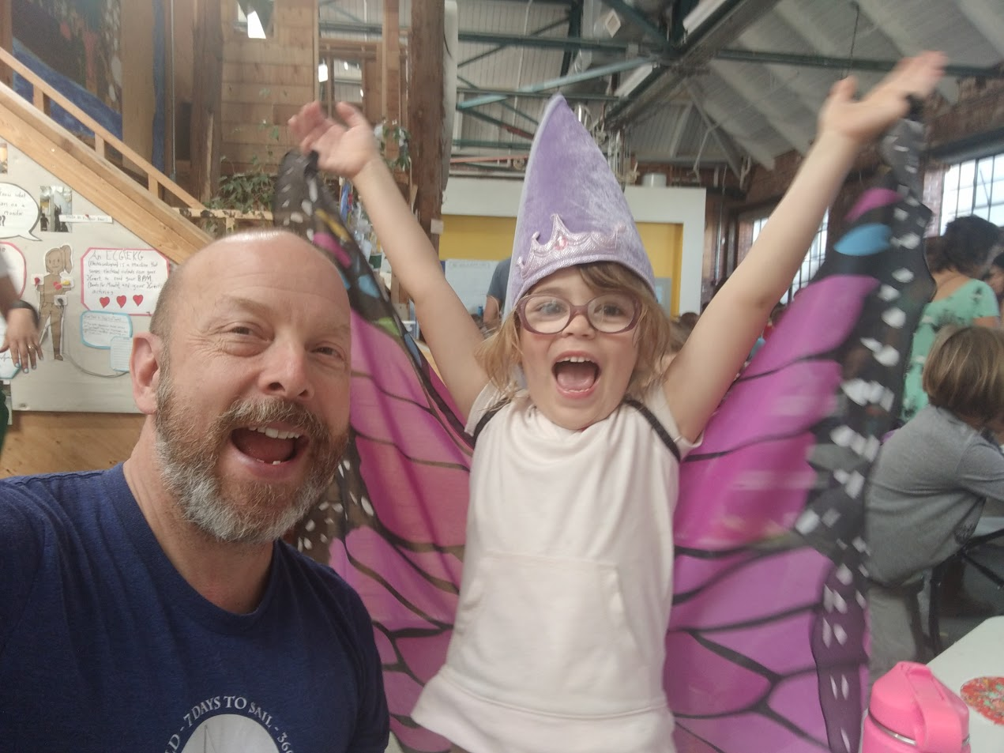
joy

Slide 12
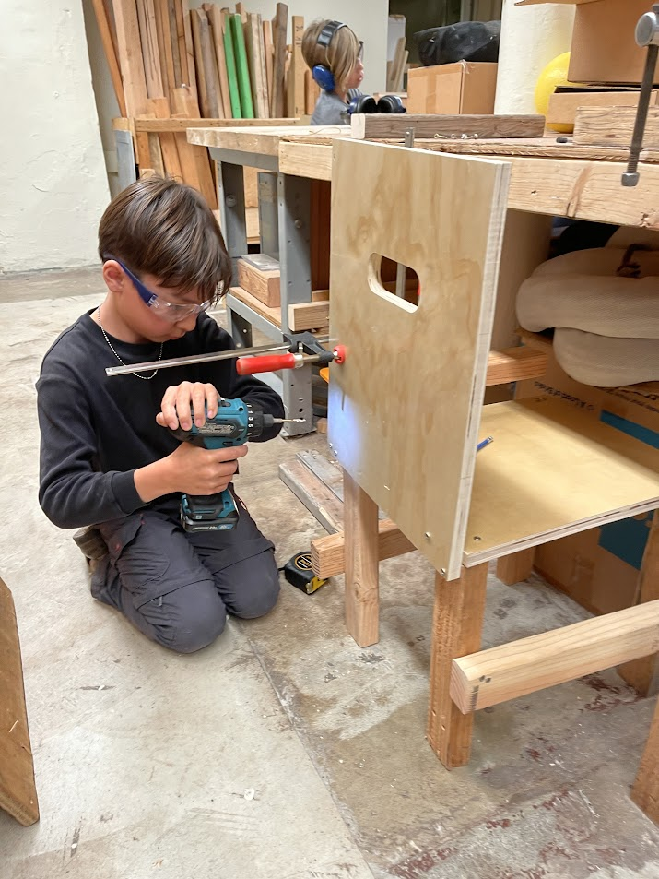
agency

Slide 13
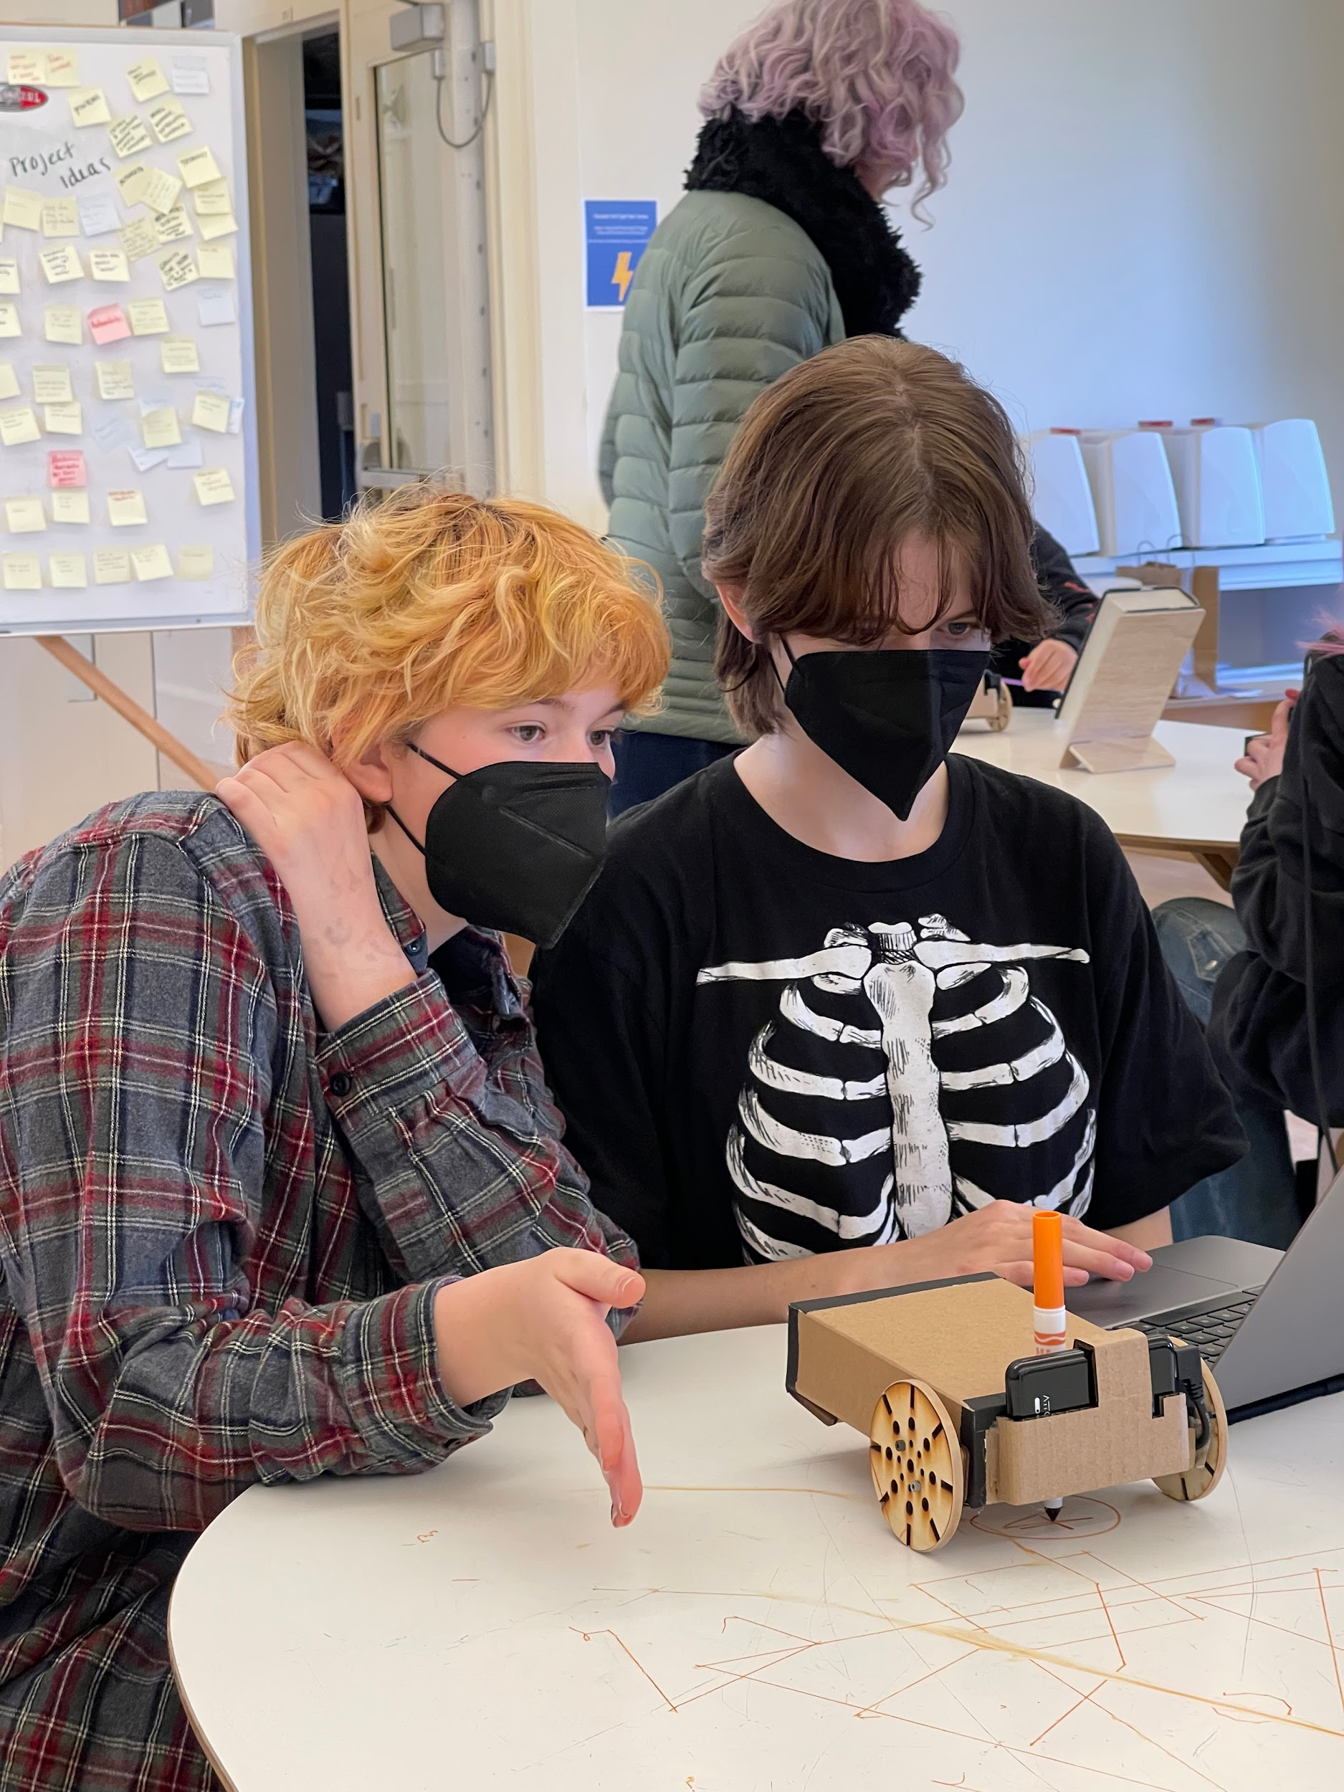
engagement

Slide 14
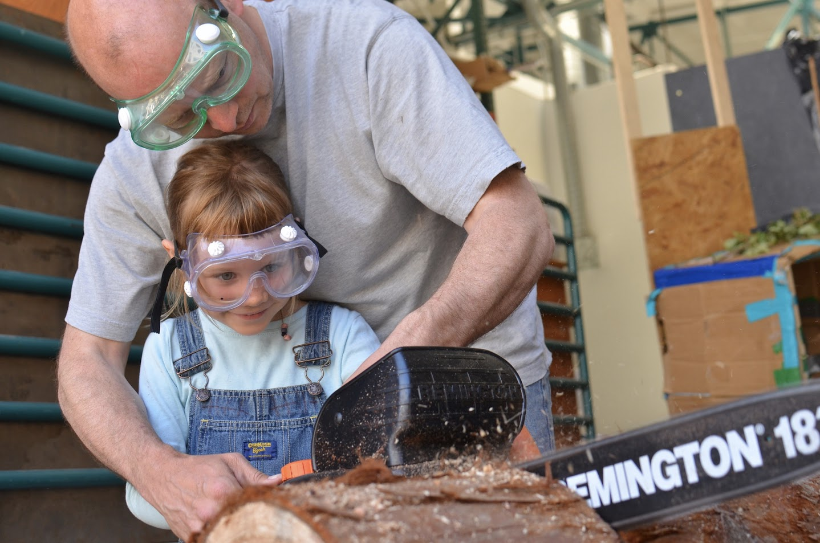
collaboration

Slide 15
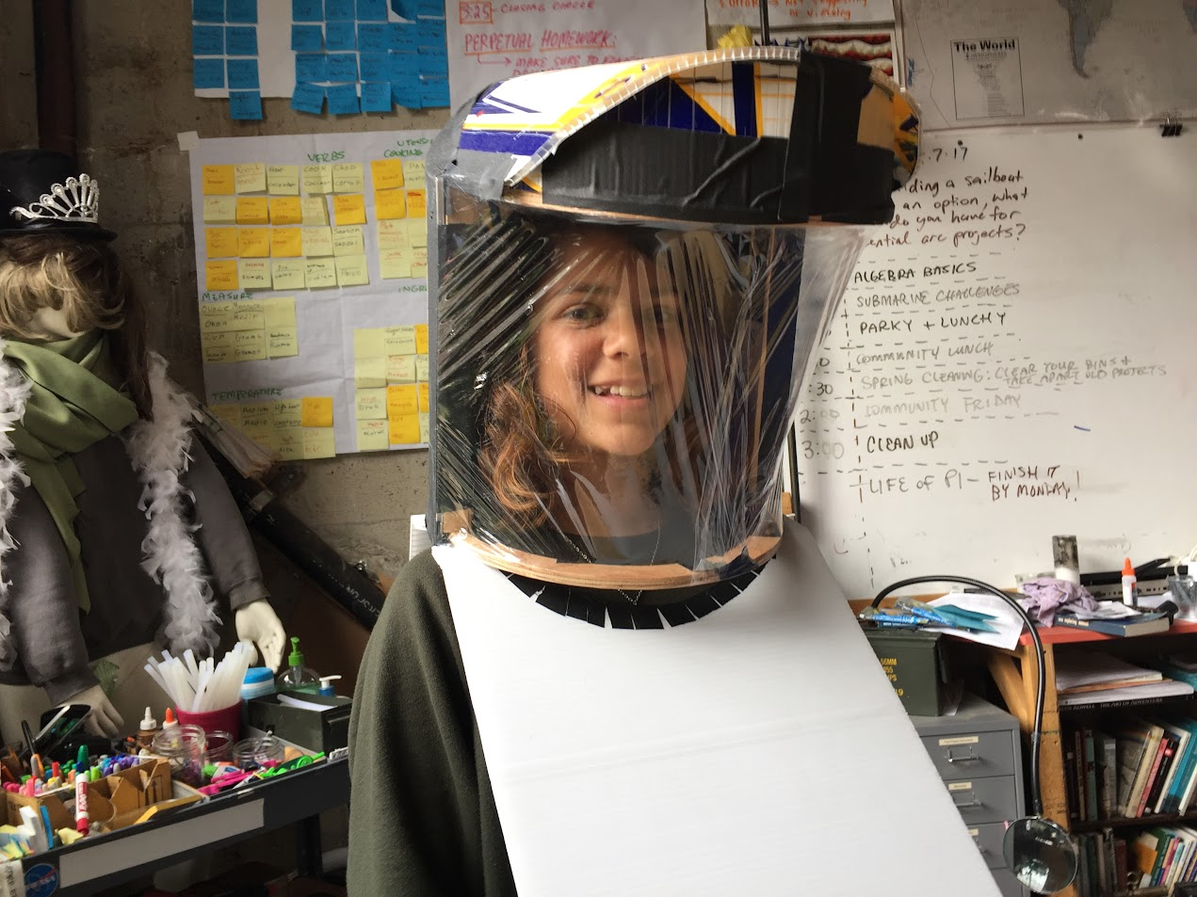
creative capacity

Slide 17
